Slide 1

WASTEWATER MANAGEMENT
Civil Engineering and Architecture
© 2010 Project Lead The Way, Inc.

Slide 2
TABLE OF CONTENTS
Wastewater Management
Reuse
Recycle
Discharge and Treatment
Publically Owned Treatment Works
On-Site and Decentralized Wastewater Treatment Systems
How Do Septic Systems Work?
Soil Tests
Reasons for Failure
Notes:
Civil Engineering and Architecture
Unit 2 – Lesson 2.3 – Residential Design
Project Lead The Way, Inc.
Copyright 2010
Wastewater Management

Slide 3
Wastewater Management
Reuse
Recycle
Discharge and Treat
Notes:
Most wastewater from a building is considered to be sanitary wastewater and can include human waste, cleaning solutions, oil and grease from cooking, food particles, and soil from cleaning clothes and floors. Commercial establishments may also discharge metals, acids and bases, and small particles of plastic, glass, stone, etc.
What happens to the wastewater that is discharged from a building through the DWV system? Wastewater is not safe to drink, and discharging this water directly into the environment (onto the ground or into a water body) can pose health and safety problems. After all, this water is part of the water cycle and will eventually make its way into a source for our water supply. The wastewater must be properly managed to protect human and environmental health and safety.
Civil Engineering and Architecture
Unit 2 – Lesson 2.3 – Residential Design
Project Lead The Way, Inc.
Copyright 2010
Wastewater Management

Slide 4
Reuse
Some relatively clean wastewater can be reused without treatment
Graywater is wastewater generated by washing, laundry, and bathing (not from toilets)
  50-80% of domestic wastewater
  Reused for irrigation or flushing toilets
Notes:
Most of the wastewater generated within a residential or light commercial building is graywater and can be reused for non-drinking purposes such as landscaping or flushing toilets. The water can be stored until needed.
Civil Engineering and Architecture
Unit 2 – Lesson 2.3 – Residential Design
Project Lead The Way, Inc.
Copyright 2010
Wastewater Management

Slide 5
Recycle
Wastewater can be treated (on-site or off-site) and reused for nondrinking purposes
  Closed-loop treatment systems are often used to capture, treat, and reuse wastewater on-site
  Wastewater reclamation involves treating the wastewater and using it for a different purpose
Notes:
Closed-loop systems are often used by car wash facilities to reuse the large quantity of wastewater generated.
An example of wastewater reclamation would be using water treated by a municipal wastewater treatment facility to irrigate public property (e.g., public golf course or park) rather than be discharged into a water body.
Civil Engineering and Architecture
Unit 2 – Lesson 2.3 – Residential Design
Project Lead The Way, Inc.
Copyright 2010
Wastewater Management

Slide 6
Discharge and Treatment
Wastewater is transported to an (on-site or off-site) treatment facility, treated, and discharged into a water body
  Publically Owned Treatment Works (POTW)
  Decentralized Wastewater Treatment System
Notes:
Civil Engineering and Architecture
Unit 2 – Lesson 2.3 – Residential Design
Project Lead The Way, Inc.
Copyright 2010
Wastewater Management

Slide 7
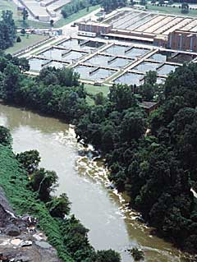
Publically Owned Treatment Works (POTW)
Owned by a state or municipality
Stores, treats, recycles, and reclaims municipal wastewater
Includes sewers, pipes, and treatment plants
Photograph by Daniel J. Hippe, U.S. Geological Survey).Courtesy USGS http://toxics.usgs.gov/pubs/FS-027-02/
Notes:
This picture shows a wastewater treatment facility near Atlanta, Georgia.
Civil Engineering and Architecture
Unit 2 – Lesson 2.3 – Residential Design
Project Lead The Way, Inc.
Copyright 2010
Wastewater Management

Slide 8
Publically Owned Treatment Works (POTW)
Treatment includes
  Primary treatment: Screening and settling
  Secondary treatment: Biological treatment in which activated sludge “eats” pollutants
  Disinfection: Kills bacteria, viruses, and protozoa
Notes:
Civil Engineering and Architecture
Unit 2 – Lesson 2.3 – Residential Design
Project Lead The Way, Inc.
Copyright 2010
Wastewater Management

Slide 9
POTW – Example Code Requirements
Minimum Pipe Size
  3 in. or 4 in. for residence
  6 in. for multi-family or commercial facility
  8 in. (at least) for industrial facility
Depth
  2 feet below lowest floor with sanitary sewage drainage
  Below frost depth
Sewer Lateral Slope
  2% min. slope (= ¼ inch per foot)
Separation
  10 feet min. horizontal distance between water and sewer lines
  Sewer lines at least 18 inches below water supply lines
Notes:
Civil Engineering and Architecture
Unit 2 – Lesson 2.3 – Residential Design
Project Lead The Way, Inc.
Copyright 2010
Wastewater Management

Slide 10
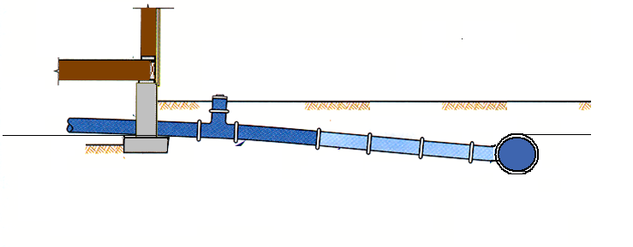

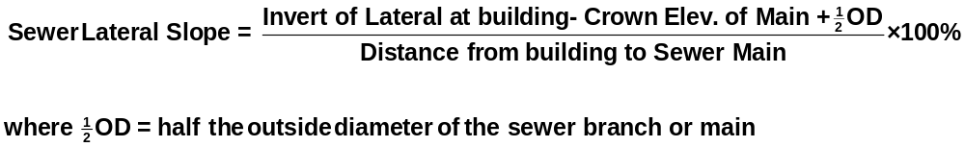
Sewer Lateral Slope
Cleanout
Sewer Main
Inv. El.
2% min. slope
Crown El.
Sewer Lateral
OD
Notes:
Because wastewater flow is typically dependent on gravity, the waste pipes must slope down in the direction of flow in order for the wastewater to be transported to the sewer main.
Copy this sketch into your notes.
Invert (Inv.) elevation refers to the elevation of the inside bottom of the pipe.
Crown Elevation refers to the elevation of the top of the pipe.
OD stands for outside diameter.
Civil Engineering and Architecture
Unit 2 – Lesson 2.3 – Residential Design
Project Lead The Way, Inc.
Copyright 2010
Wastewater Management

Slide 11
On-Site and Decentralized Wastewater Treatment System
On-site system that collects, treats, and disperses or reclaims wastewater from individual residences, businesses, or small clusters of buildings
Used when no municipal system is available
Approximately 25% of single residences in the U.S. and 33% of new developments use an on-site and decentralized system
Also called septic system, private sewage system, individual sewage treatment system, on-site sewage disposal system, or package plant
Notes:
Municipal sanitary systems (POTW) are preferable to on-site systems, but if no municipal system is easily accessible from the site, an on-site system may be the only option.
Civil Engineering and Architecture
Unit 2 – Lesson 2.3 – Residential Design
Project Lead The Way, Inc.
Copyright 2010
Wastewater Management

Slide 12
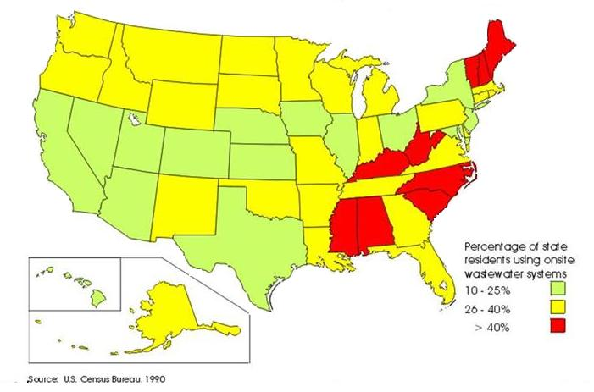
Percentage of State Residents Using Septic Systems
Notes:
More than 40 % of the population within the red states use septic systems. South Carolina, the location of the Palmetto Project, is a red state.
Civil Engineering and Architecture
Unit 2 – Lesson 2.3 – Residential Design
Project Lead The Way, Inc.
Copyright 2010
Wastewater Management

Slide 13
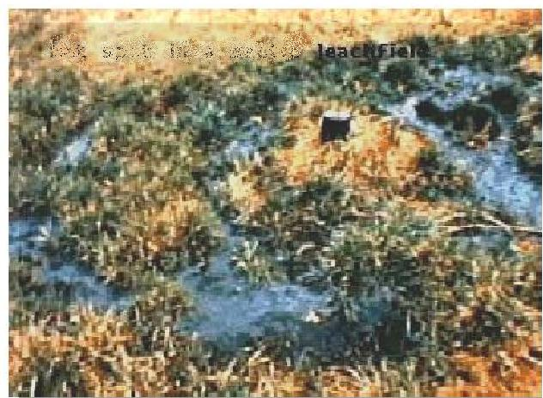
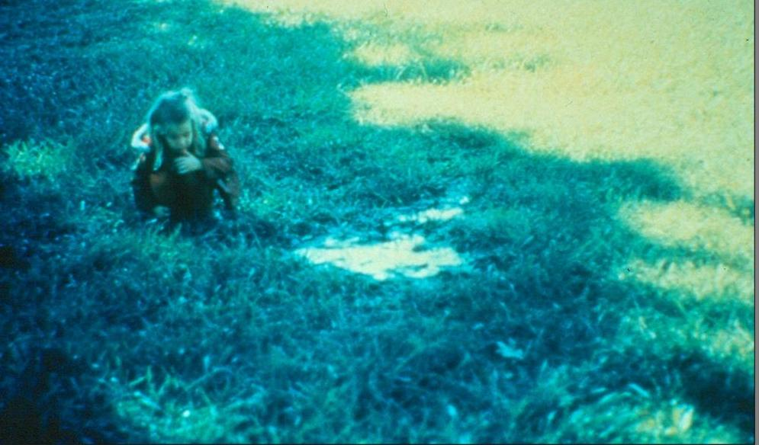
National Water Quality Problems
10 to 30 percent of systems fail annually
At least 10 percent of systems over 30 years old
Images courtesy South Carolina Department of Health and Environmental Control (SC DHEC)
Notes:
Failing septic systems have caused a water quality problem throughout the United States – between 10 and 30 percent of septic systems fail annually. When septic systems fail, sanitary wastewater may leak into nearby surface or ground water sources. Such failures expose people, animals, and vegetation to unsafe contaminates. These pictures show wet areas in septic drainfields. Saturated soils allow raw wastewater to percolate to the surface.
Civil Engineering and Architecture
Unit 2 – Lesson 2.3 – Residential Design
Project Lead The Way, Inc.
Copyright 2010
Wastewater Management

Slide 14
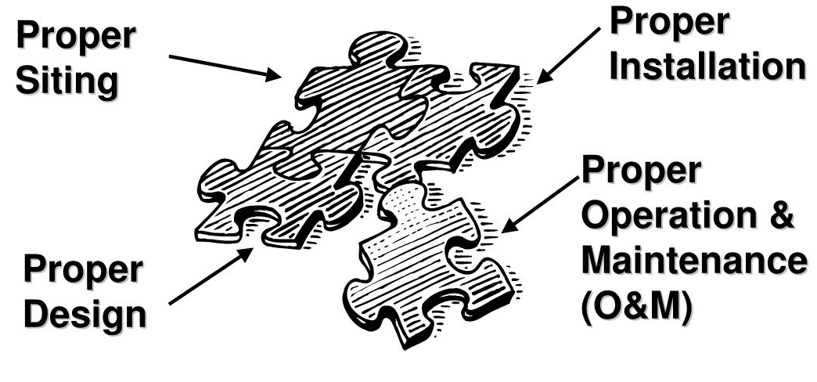
Septic Systems
Image courtesy South Carolina Department of Health and Environmental Control (SC DHEC)
Notes:
Civil Engineering and Architecture
Unit 2 – Lesson 2.3 – Residential Design
Project Lead The Way, Inc.
Copyright 2010
Wastewater Management

Slide 15
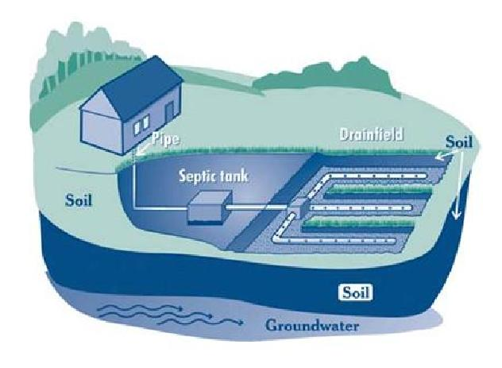
Conventional Septic System
Septic tank
Distribution box
Drainfield (leach field)
Soil
Courtesy South Carolina Department of Health and Environmental Control (SC DHEC)
Notes:
Septic systems consist of a septic tank, a drainfield (or leach field), and soil.
Civil Engineering and Architecture
Unit 2 – Lesson 2.3 – Residential Design
Project Lead The Way, Inc.
Copyright 2010
Wastewater Management

Slide 16
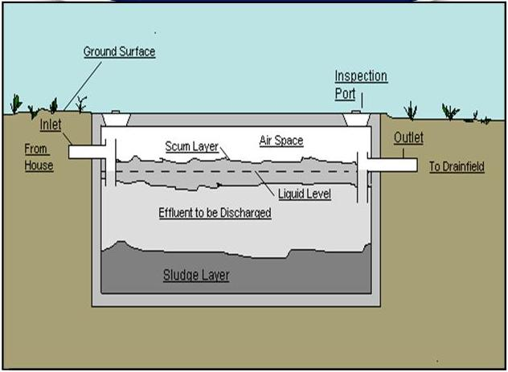
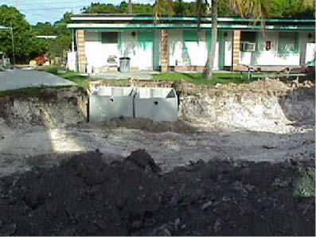
How Do Septic Systems Work?
Septic tank holds liquid for about 2 days
  Sludge (heavy solids) settles out
  Scum (grease, oil, floating debris) rises to surface
  Anaerobic decomposition breaks down some solids
  Tank should be pumped out regularly
Courtesy South Carolina Department of Health and Environmental Control (SC DHEC)
Courtesy USGS http://sofia.usgs.gov/publications/posters/hydro_flkeys/concerns.html
http://sofia.usgs.gov/publications/posters/hydro_flkeys/concerns.html
Notes:
The image on the left shows the internal workings of a septic system.
[click] The image on the right shows the installation of several septic tanks for a motel in Florida.
Civil Engineering and Architecture
Unit 2 – Lesson 2.3 – Residential Design
Project Lead The Way, Inc.
Copyright 2010
Wastewater Management

Slide 17
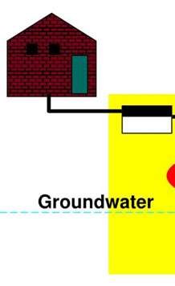


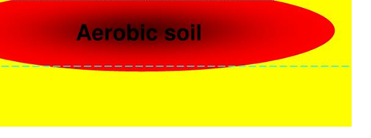
How Do Septic Systems Work?
Septic Tank
Distribution Box
Drainfield
Courtesy South Carolina Department of Health and Environmental Control (SC DHEC)
Notes:
The wastewater is discharged from the septic tank [click] to the distribution box [click].
The distribution box disperses the liquid to the drainfield [click].
The drainfield is made up of perforated pipes on a bed of gravel which are buried underground.
The wastewater infiltrates the soil [click] surrounding the drainfield.
The intent is that the soil filters (treats) the wastewater before it enters the groundwater or a nearby body of water.
Civil Engineering and Architecture
Unit 2 – Lesson 2.3 – Residential Design
Project Lead The Way, Inc.
Copyright 2010
Wastewater Management

Slide 18
Soil Tests
Required tests vary among jurisdictions
Check with local building department
Percolation (perc) test
  Dig holes
  Fill with water
  Measure the rate of infiltration
Length of the drainfield pipes is based on infiltration rate
Notes:
Some soils cannot adequately accept or treat wastewater. Most jurisdictions require that the soil on which the septic system will be built is evaluated to make sure it can provide adequate treatment. You should check with your local building department to determine how the soil must be evaluated. In some cases local officials must perform the testing.
One example of a soil evaluation method that may be required is the percolation test. A perc test is one method to estimate the rate of water infiltration into the soil. There are many different ways to perform a percolation test – the local building department may identify a specific testing method. A perc test basically consists of digging several holes in the proposed location of the drainfield, filling the holes with water, and timing the drop of the water level to determine the rate of infiltration in each hole.
The length of the drainfield is based on the infiltration rate.
Although some municipalities still require a percolation tests in order to obtain a permit to construct a septic system, perc tests have been found to be unreliable in certain cases, especially during a season of heavy rain or drought. Many jurisdictions no longer allow the use of percolation tests to determine infiltration rates. It may be necessary to have the soil evaluated by a professional engineer, geologist, or environmental specialist in order to obtain a permit.
Civil Engineering and Architecture
Unit 2 – Lesson 2.3 – Residential Design
Project Lead The Way, Inc.
Copyright 2010
Wastewater Management

Slide 19
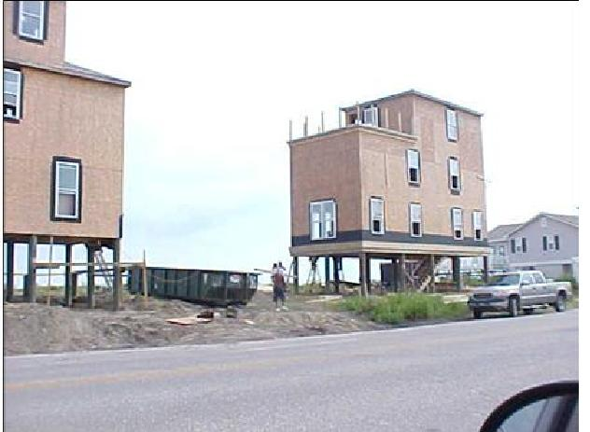
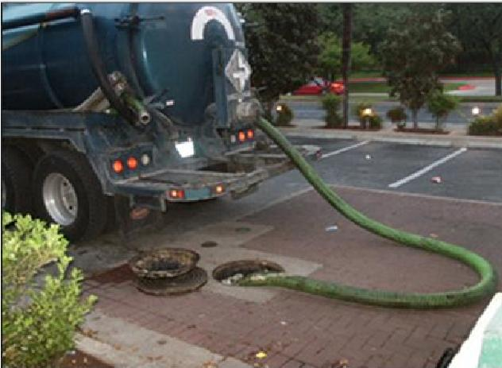
Reasons for Failure
Poor soils
Drainfield within high water table
System undersized
Poor construction
Poor maintenance
Images Courtesy South Carolina Department of Health and Environmental Control (SC DHEC)
Notes:
The top picture shows a water front property with a high water table. This property is not suitable for a septic system.
Proper maintenance is essential in order to keep the on-site decentralized system working properly. The second picture shows a pump truck removing sludge and scum from a commercial septic system tank.
Civil Engineering and Architecture
Unit 2 – Lesson 2.3 – Residential Design
Project Lead The Way, Inc.
Copyright 2010
Wastewater Management

Slide 20
TABLE OF CONTENTS
Wastewater Management
Reuse
Recycle
Discharge and Treatment
Publically Owned Treatment Works
On-site and Decentralized Wastewater Treatment Systems
How Do Septic Systems Work?
Soil Tests
Reasons for Failure
Notes:
Civil Engineering and Architecture
Unit 2 – Lesson 2.3 – Residential Design
Project Lead The Way, Inc.
Copyright 2010
Wastewater Management

Slide 21
Resources
South Carolina Department of Health and Environmental Control. (n.d.). Septic systems in coastal South Carolina for professional real estate professionals. Retrieved November 20, 2009, from http://www.scdhec.gov/environment/ocrm/plan_tech/docs/septic_realtor.pdf
United State Geological Survey. (n.d.). South Florida Information Access - Hydrogeology of a Dynamic System in the Florida Keys: A Tracer Experiment. . Retrieved December 15, 2009, from http://sofia.usgs.gov/publications/posters/hydro_flkeys/concerns.html
Notes:
Civil Engineering and Architecture
Unit 2 – Lesson 2.3 – Residential Design
Project Lead The Way, Inc.
Copyright 2010
Wastewater Management

